Slide 1
Excel Chart and Table Formatting

Slide 2
Excel Chart - Requirements
Help standardize the charts and tables for 2 companies (AceEngineer & STA)
A VB program (Macro) should converted an “Unformatted” chart into a “formatted” chart.
State or identify limitations on usage : Line chart, bar chart? etc.
Useful resources:
Online
VB programming guide (0026-XLS-0001-01)

Slide 3
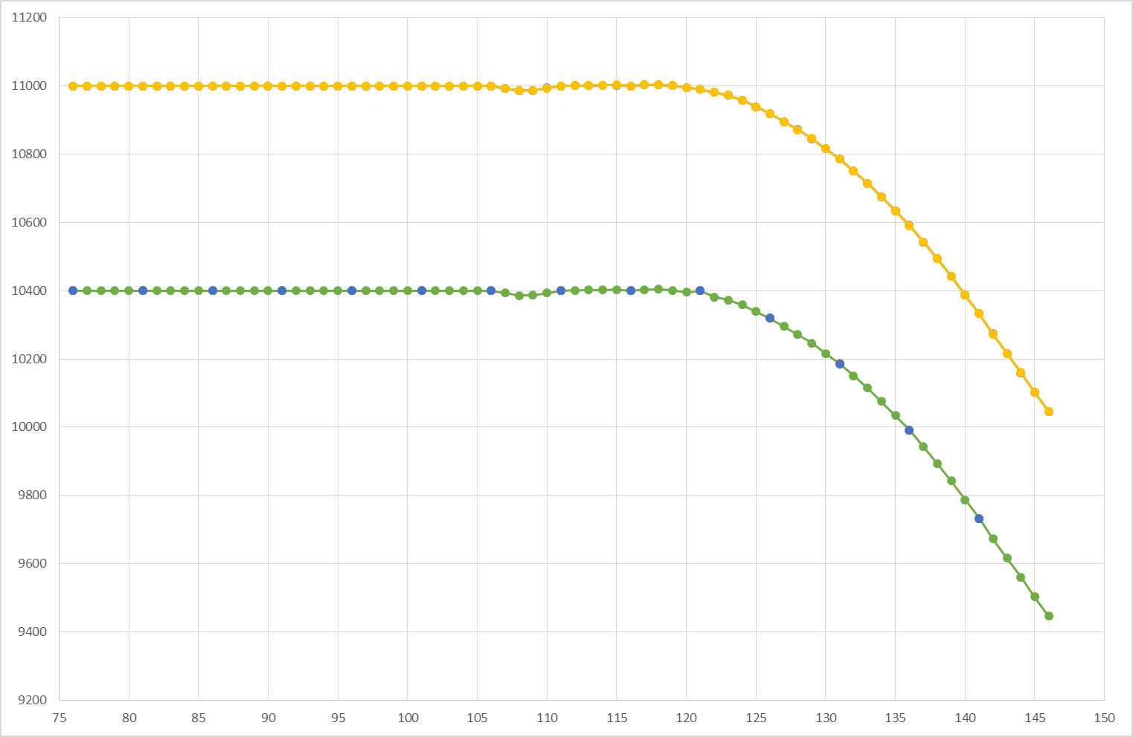
Chart – Not Formatted, without titles
A chart when plotted directly without formatting is shown below

Slide 4
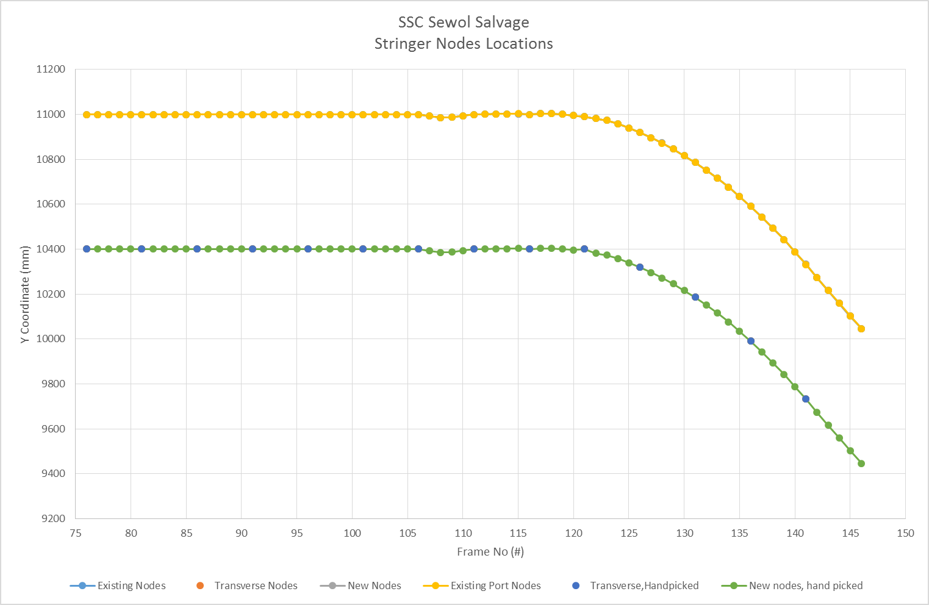
Chart – Not Formatted, with titles
A chart when plotted and titles were added looks as below

Slide 5
If we Manipulate Manually
Time consuming
3-4 engineers manipulate this, it will NOT be consistent
So a program will help us standardize this.
VB (Visual Basic) program that can be implemented in Excel

Slide 6
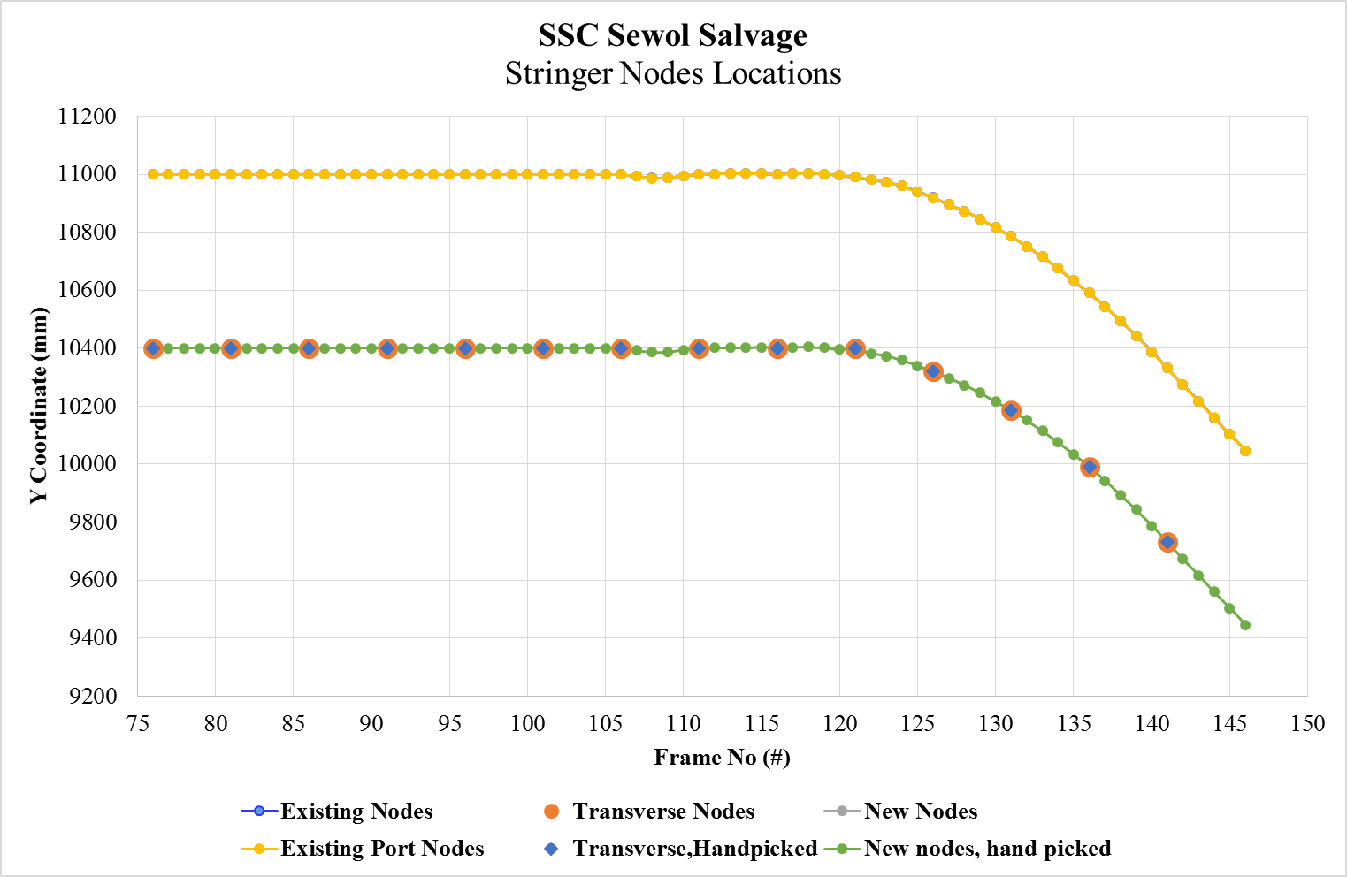
Chart – Formatted
A chart when formatted looks as below

Slide 7
Introduction to VB
VB (Visual Basic) program that can be implemented in Excel
http://www.excel-vba.com/excel-vba-solutions-beginners.htm
http://www.thespreadsheetguru.com/blog/2015/3/1/the-vba-coding-guide-for-excel-charts-graph

Slide 8
Presentation Title
01 | New document | 20 January 2016 |  | V Achanta | - | -
Rev | Description | Date |  | Author | Checked | Approved
Document No: 0119-PRS-0001 |  |  | Client Ref:
 |  |  | -

Slide 9
Web Interactive Charts

Slide 10
Web Charts - Requirements
Web interactive chart technology can be used for engineering web reports.
Interactive charts will help create rich user interaction for clients
D3JS chart technology can be used for creating charts for
Websites
Online and mobile apps

Slide 11
Other Programming Tasks
0119-PRE-0001
11 February 2016

Slide 12
Introduction
All the programming tasks:
Excel chart and Table format programming
Web Reports (with interactive charts)
AceEngineer Website programming
STA Website programming (blogs and other improvements)
Microsoft Windows app programming
3DMax graphic programming
Tecplot programming
ANSYS Python automation – ACT
Python programming capabilities

